Slide 1
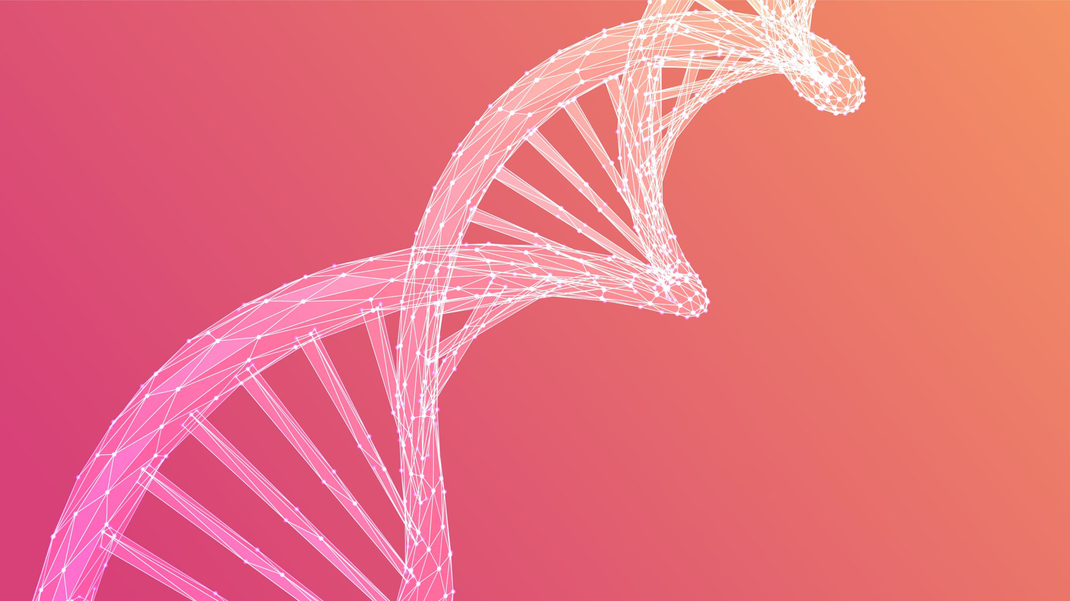
Genetic Algorithms Project
Antonio Trujillo
Alberto Trigueros
Jesús Fuentes
María Peinado
Group C

Slide 2

INDEX
1. Introduction.
2. Structure of the application, design choices
3. Experimental results, performance slots, coments

Slide 3


INTRODUCTION
This project is focused on creating a function with the ability of solving a Sudoku puzzle by using a genetic algorithm. In following slides, we are going to explain how we got that.

Slide 4
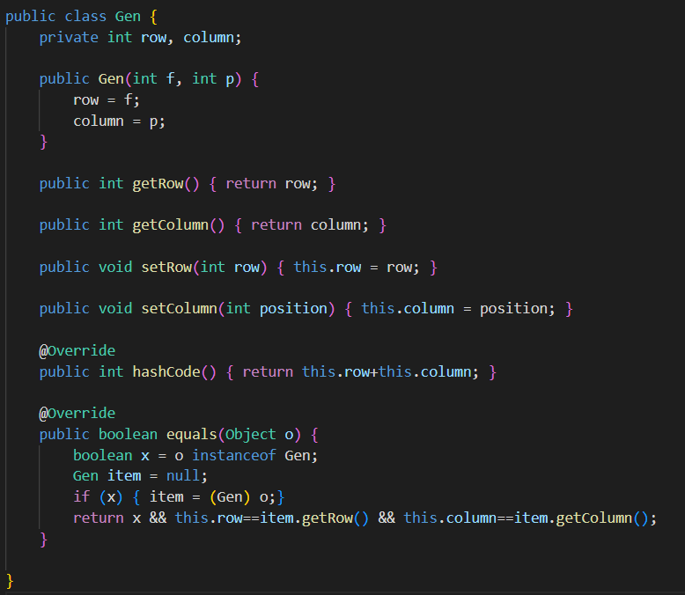

Structure of the application, design choices
CLASS GEN
To build a gen we need the row and the column
The corresponding gets and sets
Two gens are equal if their position is the same (row and column)

Slide 5
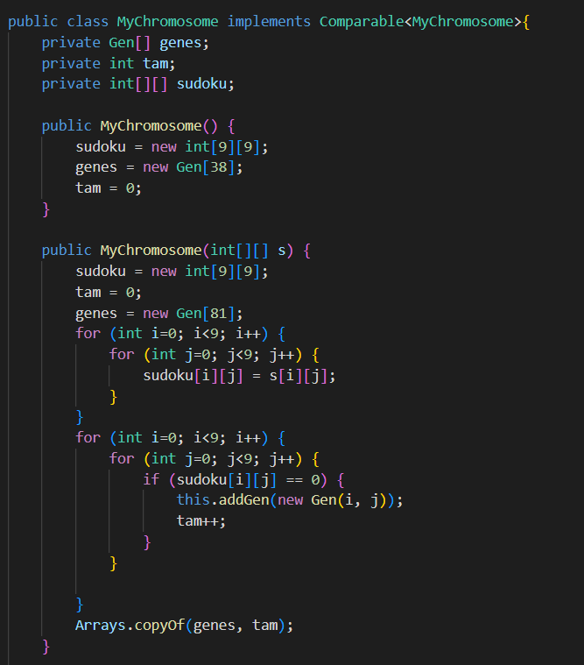
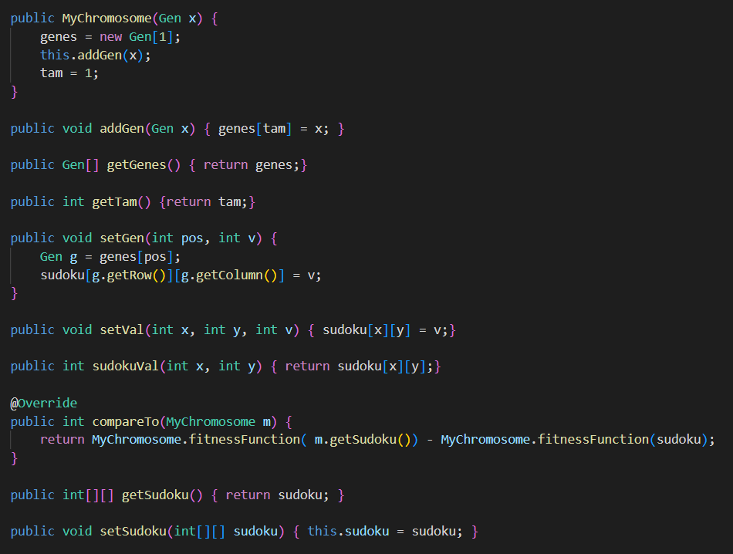
Structure of the application, design choices
CLASS MYCHROMOSOME
An other constructor by using one gen
To set a gen in the sudoku we use it’s position
Constructor with the sudoku
The empty holes of the sudoku will determine the list of our gens
We establish that a chromosome is bigger than others if its fitnessFunction is bigger

Slide 6
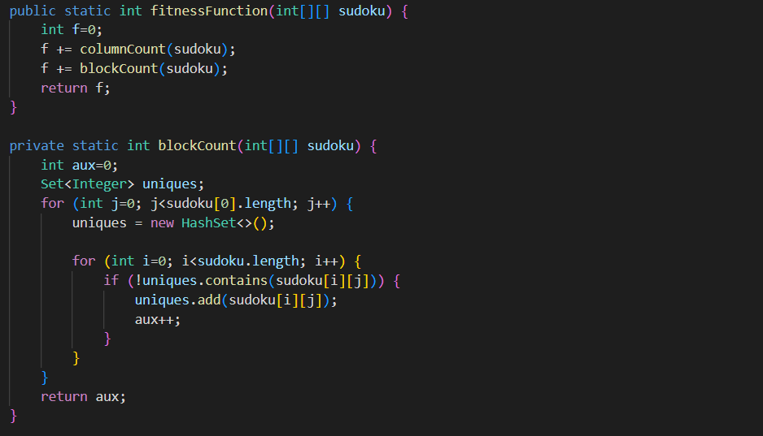
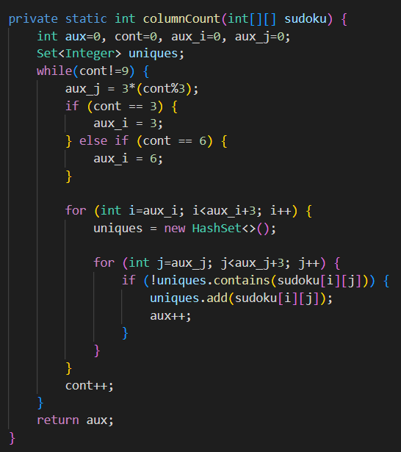
Structure of the application, design choices
CLASS MYCHROMOSOME
The fitness function will be the number of unique values in each block and column
We count the unique values in each column
We count the unique values in each block

Slide 7
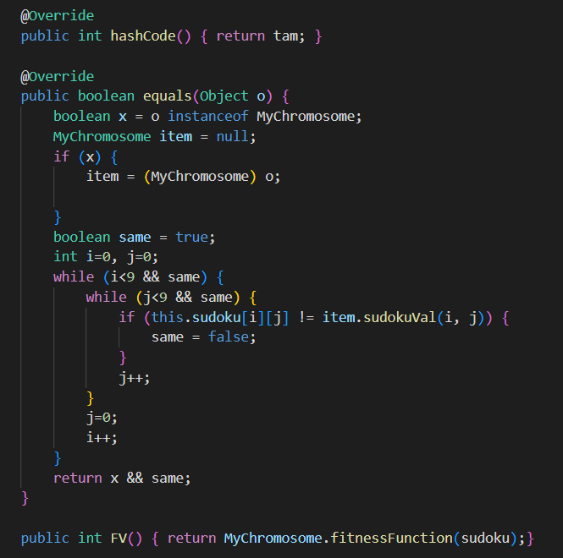
Structure of the application, design choices
CLASS MYCHROMOSOME
Two chromosome will be the same if the contain the same sudoku and the same number of gens

Slide 8
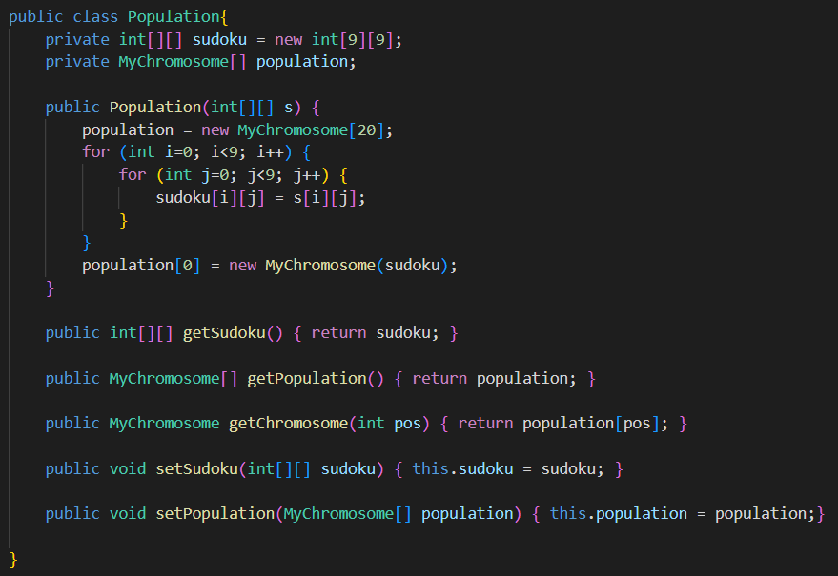
Structure of the application, design choices
CLASS MYCHROMOSOME
We initialize the first chromosome with the sudoku given
A population is made of 20 chromosomes
The corresponding gets and sets

Slide 9
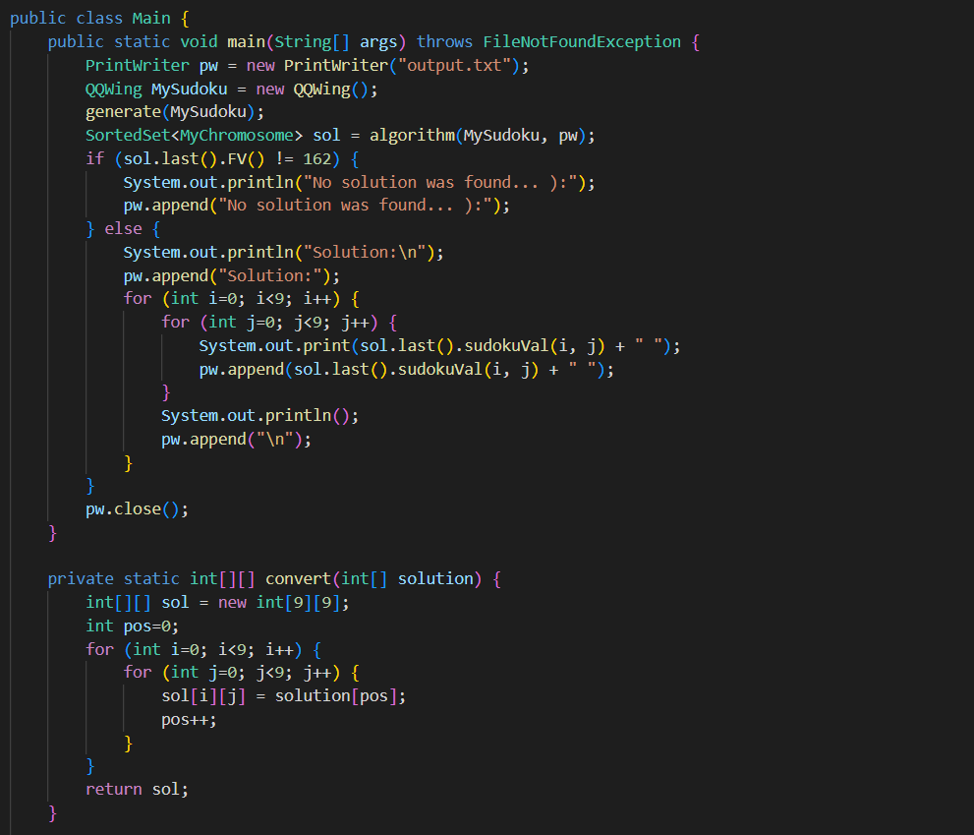
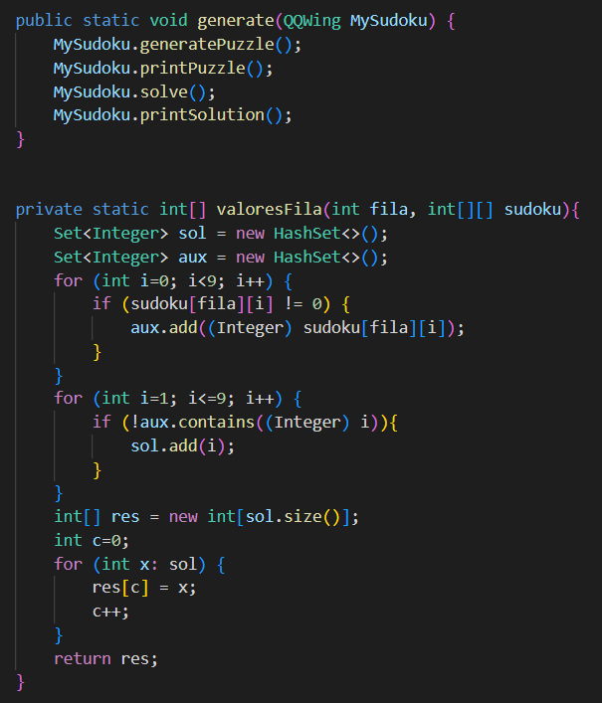
Structure of the application, design choices
CLASS MAIN
Prints the solution of the sudoku

Slide 10
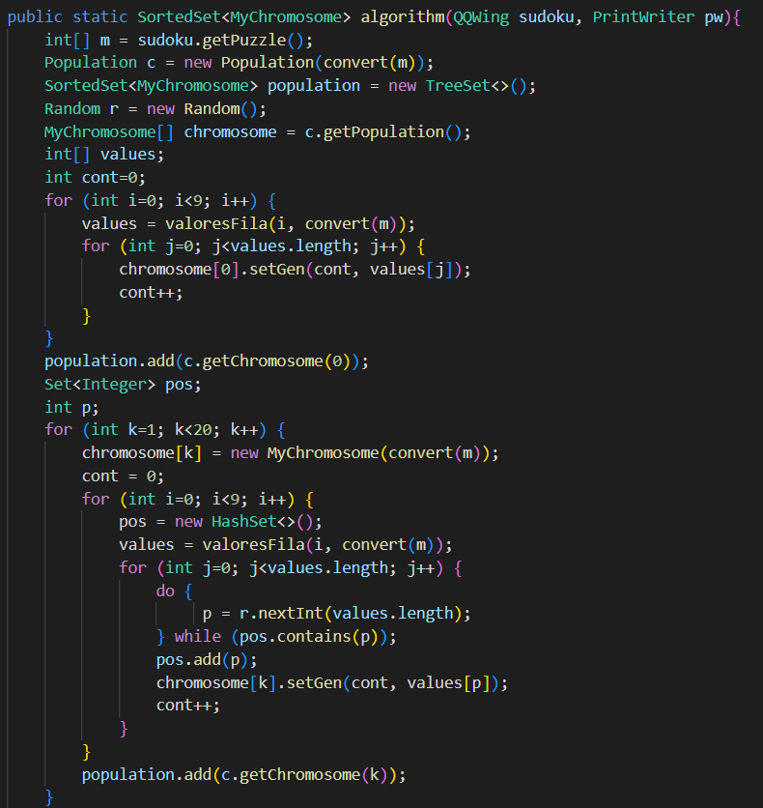
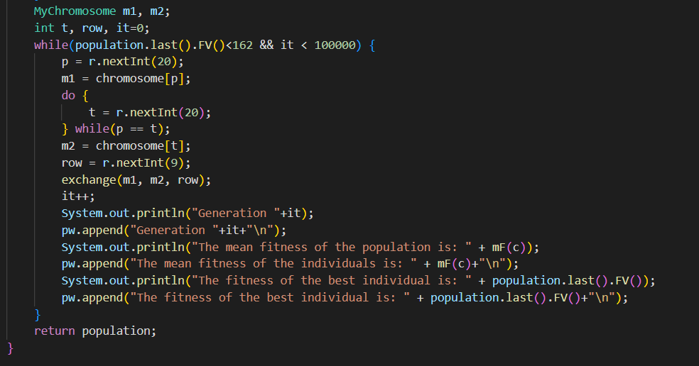
Structure of the application, design choices
CLASS MAIN
Convert an array into a matrix
The missing values will be assign to the gens of the chromosome
As we are ussing a sorted set the last will be the one with greater fitness function. While this is lower than 162 we Will be exchanging using two random chromosome and the row.
Now we are going to do the same but with the 19 chromosomes lefts.

Slide 11
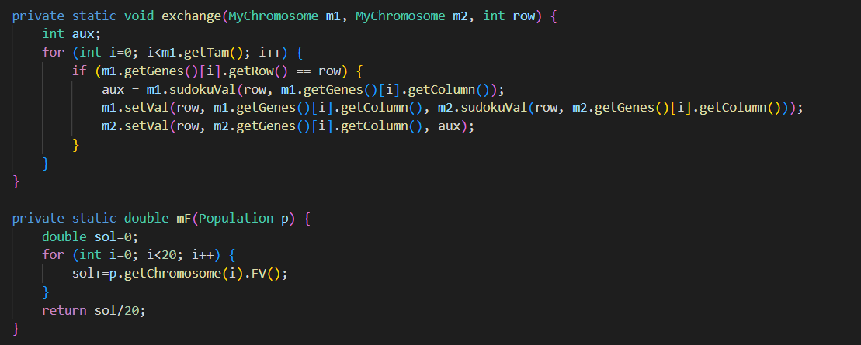
Structure of the application, design choices
CLASS MAIN

Slide 12
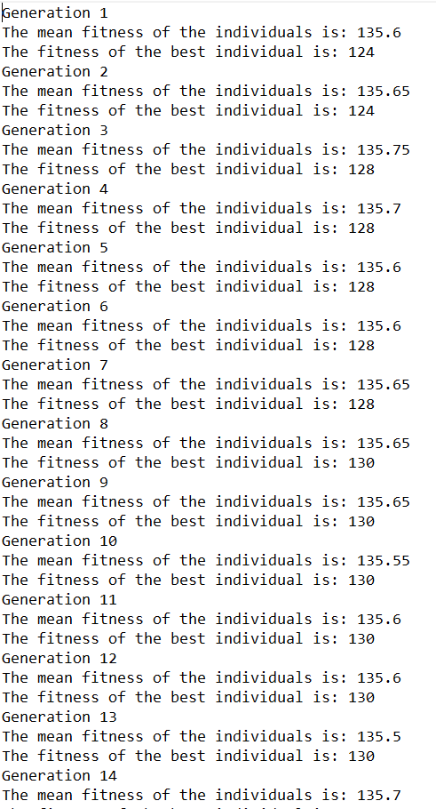
Experimental results, performance slots, coments
Although we have done a lot of iterations changing row of genes, they weren’t enough. So, we could not get the solution. But we were so close

